Slide 1


Agenda
Research Problem
Adopted Concepts
Proposed Solution
Study Purpose
Participatory Design Approach
Case Study

Slide 2
Agenda
Research Problem
Adopted Concepts
Proposed Solution
Study Purpose
Participatory Design Approach
Case Study

Slide 3
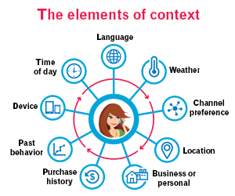

Research Problem
Most software systems operate within a complex and variable context.
Challenge: ensure that requirements keep pace with the changing context.

Slide 4


Acquiring Users’ Input
Requirements are gathered from a diverse groups of users.
Requirements are volatile in nature.
Challenge: users provide their feedback on the fulfilment of requirements in a very restrictive manner such as ranking
Challenge: or users provide their feedback on the fulfilment of requirements either in a natural language and an ad-hoc manner

Slide 5

Feedback Analysis
A range of semi-automated techniques have been suggested to handle such user data
Benefits: These techniques may be used to gather, interpret, aggregate, and revise what users say
Challenges: issues such as bias and subjectivity

Slide 6
Agenda
Research Problem
Adopted Concepts
Proposed Solution
Study Purpose
Participatory Design Approach
Case Study

Slide 7
Software Change Management Process
Request a Change
Identify Change
Impact Analysis
Planning
Implement Change
Review and Closure

Slide 8
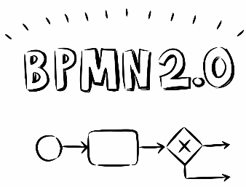
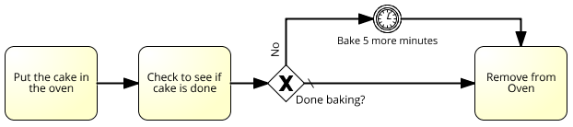
Business Process Models

Slide 9
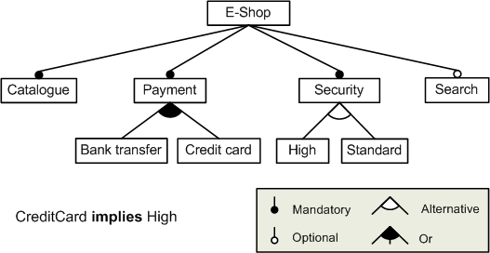
Feature Model

Slide 10
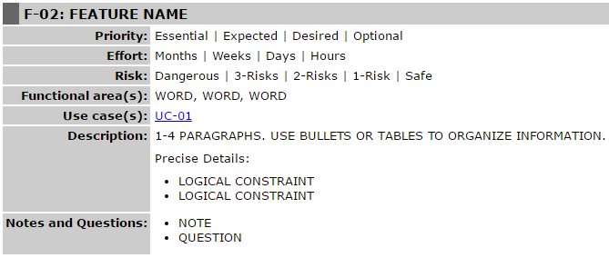
Feature Specification Document

Slide 11
Agenda
Research Problem
Adopted Concepts
Proposed Solution
Study Purpose
Participatory Design Approach
Case Study

Slide 12
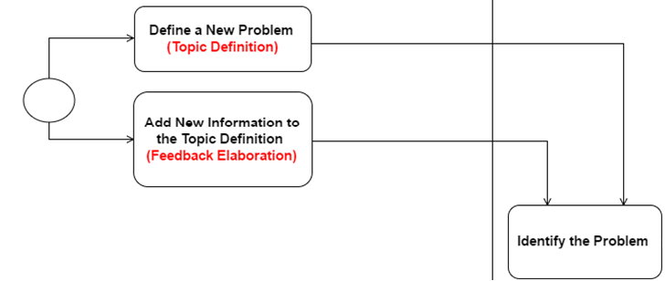
Communication Process (1)

Slide 13
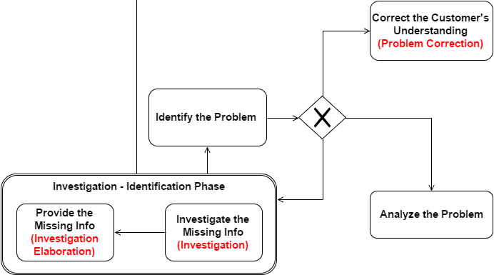
Communication Process (2)

Slide 14
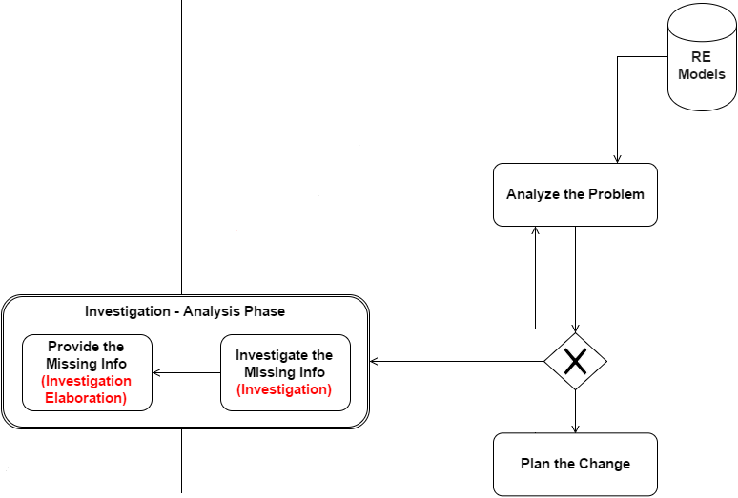
Communication Process (3)

Slide 15
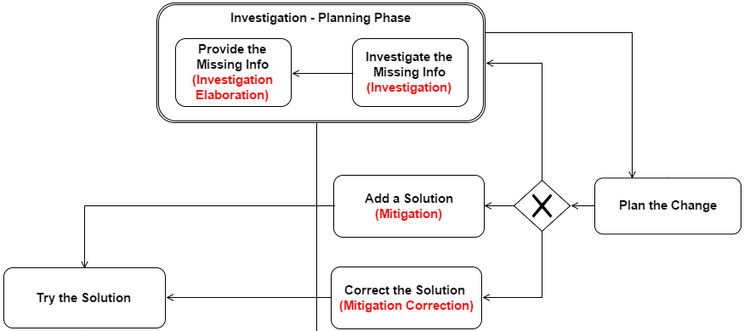
Communication Process (4)

Slide 16
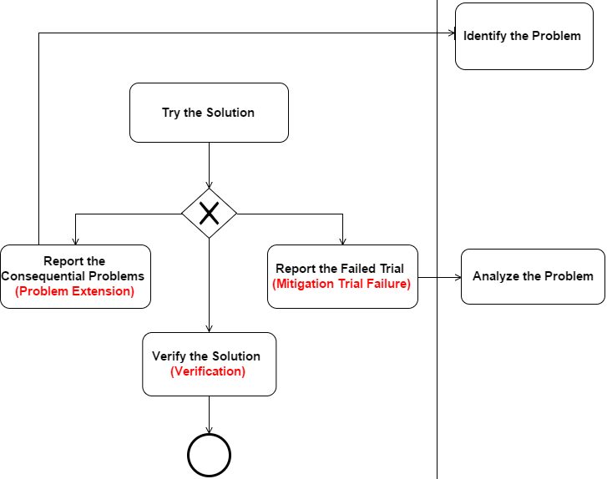
Communication Process (5)

Slide 17
Communication Process (6)
Complete Process Workflow

Slide 18
Feedback Threads
Topic
Investigation 1
Investigation Elaboration 1
Investigation 2..
Investigation Elaboration 2..
Feedback Elaboration
Mitigation
Verification
Mitigation Trial Failure
Problem Extension
Investigation 1..
Investigation Elaboration 1..
Mitigation
Mitigation Correction
Verification
Problem Correction

Slide 19
Agenda
Research Problem
Adopted Concepts
Proposed Solution
Study Purpose
Participatory Design Approach
Case Study

Slide 20
Study Purpose
To design and evaluate the use and benefits of the feedback types in practice
To evaluate the use of RE models and its role in facilitating the engineer tasks and keeping the requirements information up to date
To design and evaluate the use and benefits of Attempto Controlled English in structuring the end-user feedback
To evaluate the new augmented software change management process and user involvement in the process
To design a workflow for engineers to ensure requirements are kept up-to-date.

Slide 21
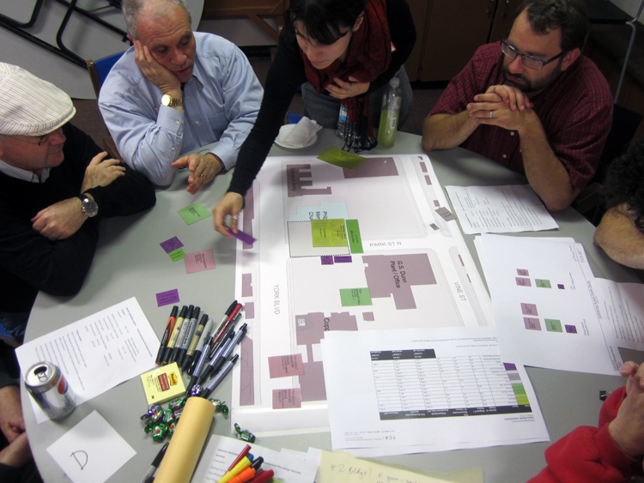
PD Approach

Slide 22
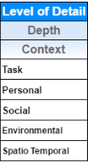
Levels of Detail - Context
Task: It used to describe what the user is doing. Or it is used in describing the frequent jobs that the user is involved in in his daily work.
Personal: users express their emotional judgments, stress, or info about their expertise.
Social: related to a user’s role at work, or information about co-workers.
Environmental: information related to a software or hardware specs, versions, architectures…etc.
Spatio Temporal: specifies information related to place and time.
Timing relationship between two tasks
Information about a problem in relation to where it occurs in software

Slide 23
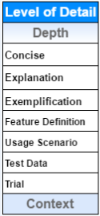
Levels of Detail - Depth
Concise: providing short feedback with no explanations
Explanation: providing detailed feedback
Exemplification: utilized when you need to provide examples within this text.
Feature Definition: corrects the misunderstanding of a user
Usage Scenario: corrects the misunderstanding of a user
Test Data:
Configuration files that describe their environmental context
Test data for the data formats that were used when the problem occurred
Trial: to show the user's attempts to resolve his problem, but has failed to reach a solution.

Slide 24
Methods
Text
Question
Snapshots
Links
Files
Attempto Controlled English

Slide 25
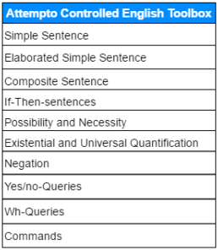
Attempto Controlled English (ACE)
There is a customer.
A bank's trusted customer X inserts two valid cards of himself
A customer inserts a card and an automated teller checks the code.
A customer inserts a card or enters a code.
If a card is valid then a customer inserts it.
A trusted customer can insert a card.
It is necessary that a trusted customer inserts a card.
Every customer inserts a card.
A customer does not insert a card.
Does a customer insert a card?
How does a customer insert a card?
John, go to the bank!

Slide 26
Agenda
Research Problem
Adopted Concepts
Proposed Solution
Study Purpose
Participatory Design Approach
Case Study

Slide 27
Moodle
Moodle is a free and open-source software learning management system written in PHP and distributed under the GNU General Public License.
Developed on pedagogical principles, Moodle is used for blended learning, distance education, and other e-learning projects in schools, universities, workplaces and other sectors.
With customizable management features, it is used to create private websites with online courses for educators and trainers to achieve learning goals.

Slide 28

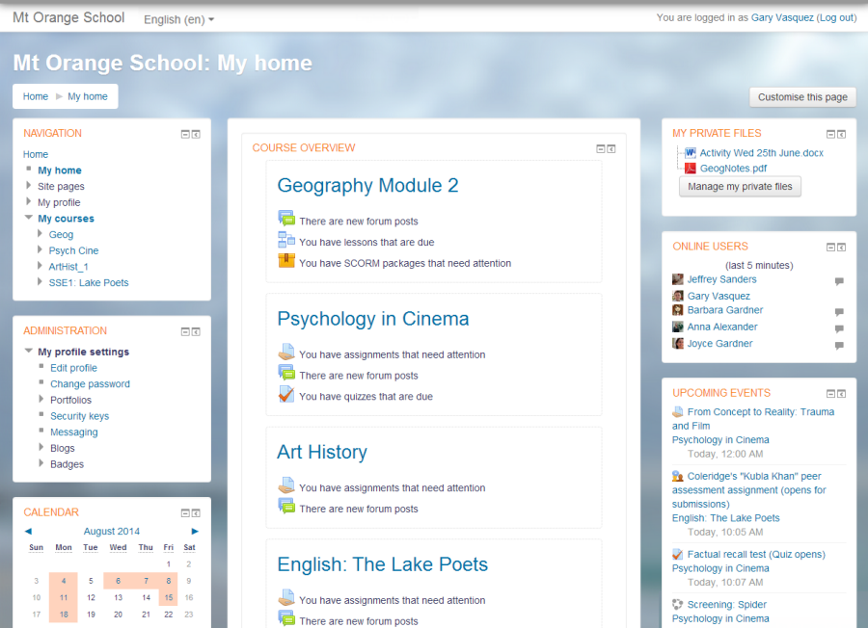

Slide 29
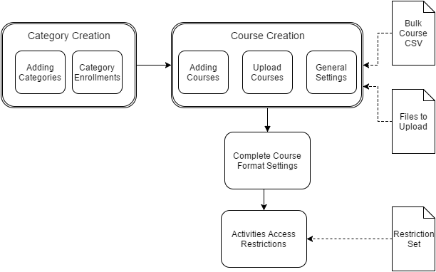
Business Process Model for Moodle

Slide 30
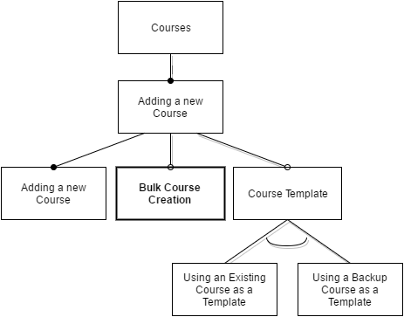
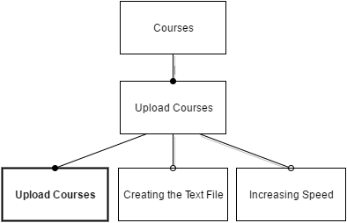
Feature Model for Moodle
Bulk course creation implies Upload Courses

Slide 31
Link between BPM and FM
Business Process Model Task | Feature
Course Creation Transaction
Task: Adding Courses | Bulk Course Creation
Task: Upload Courses | Upload Course

Slide 32
Case Study (1)
Courses
Courses are the spaces on Moodle where teachers add learning materials and activities for their students. Courses may be created by admins, course creators or managers. Teachers can then add the content and re-organise them according to their own needs.
Module: Adding a new course
Feature: Bulk course creation
This feature enables users to create several courses at once by defining them in a CSV file. For full details on how to bulk create courses and use course templates, see Module: Upload courses.

Slide 33
Case Study (2)
Module: Upload courses
Feature: To upload one or more courses
Go to Administration > Site administration > Courses > Upload courses
Either drag and drop the CSV file or click the 'Choose a file' button and select the file in the file picker
Select appropriate import options carefully, and then click the preview button.

Slide 34
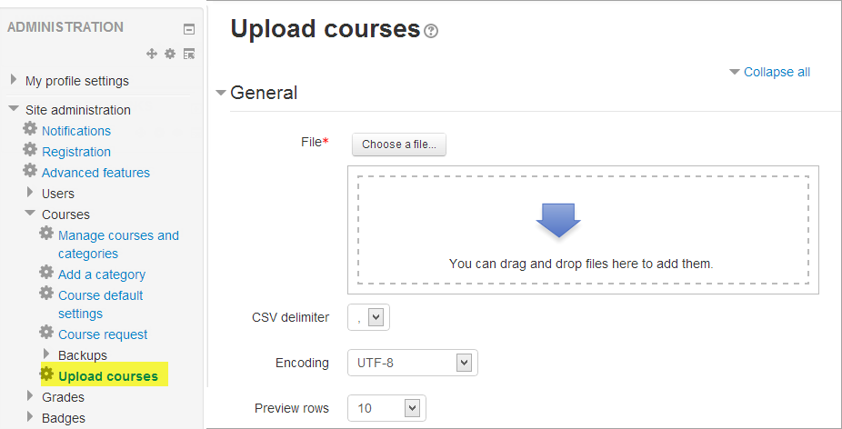
Case Study (3)

Slide 35
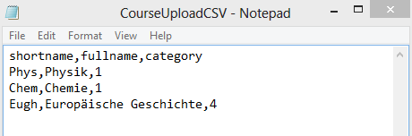
Case Study (4)
Problem
Suppose you created a CSV file containing a list of new courses he wants to add in German language as shown in the figure below:

Slide 36
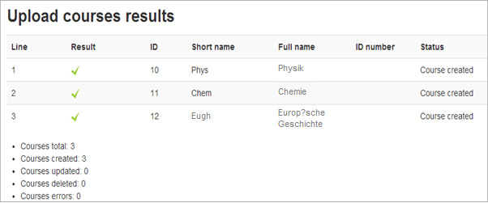
Case Study (5)
Problem
After you uploaded the CSV file, and you viewed the uploaded course results, the special German character “ä” is replaced with incorrect symbols “?”, such as in line 3 shown below:

Slide 37
Templates
See Topic Template
See Investigation Template
See Investigation Elaboration Template
See Problem Correction Template

Slide 38

Questions

